Slide 1
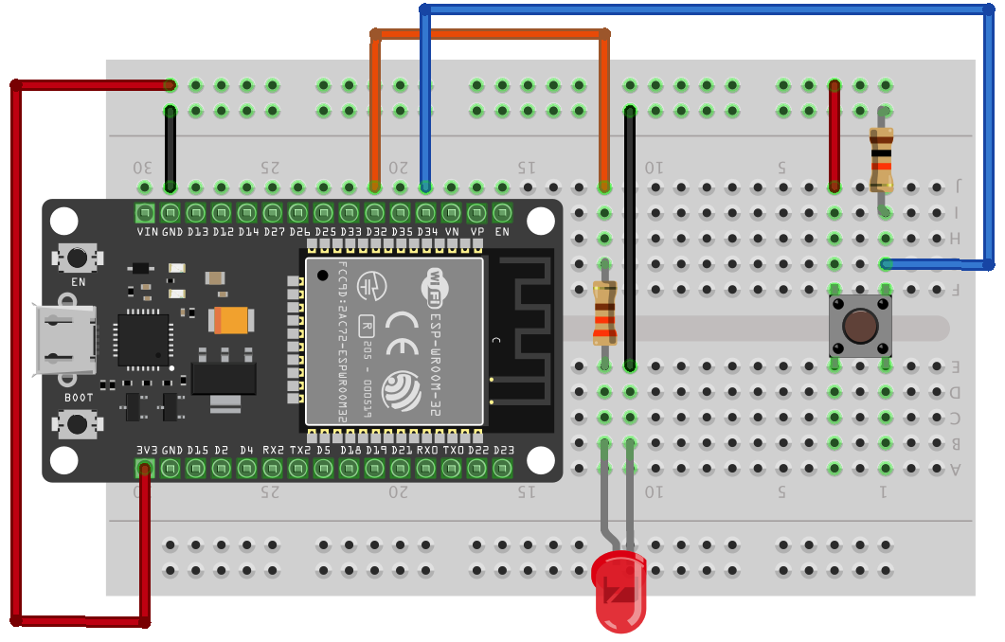
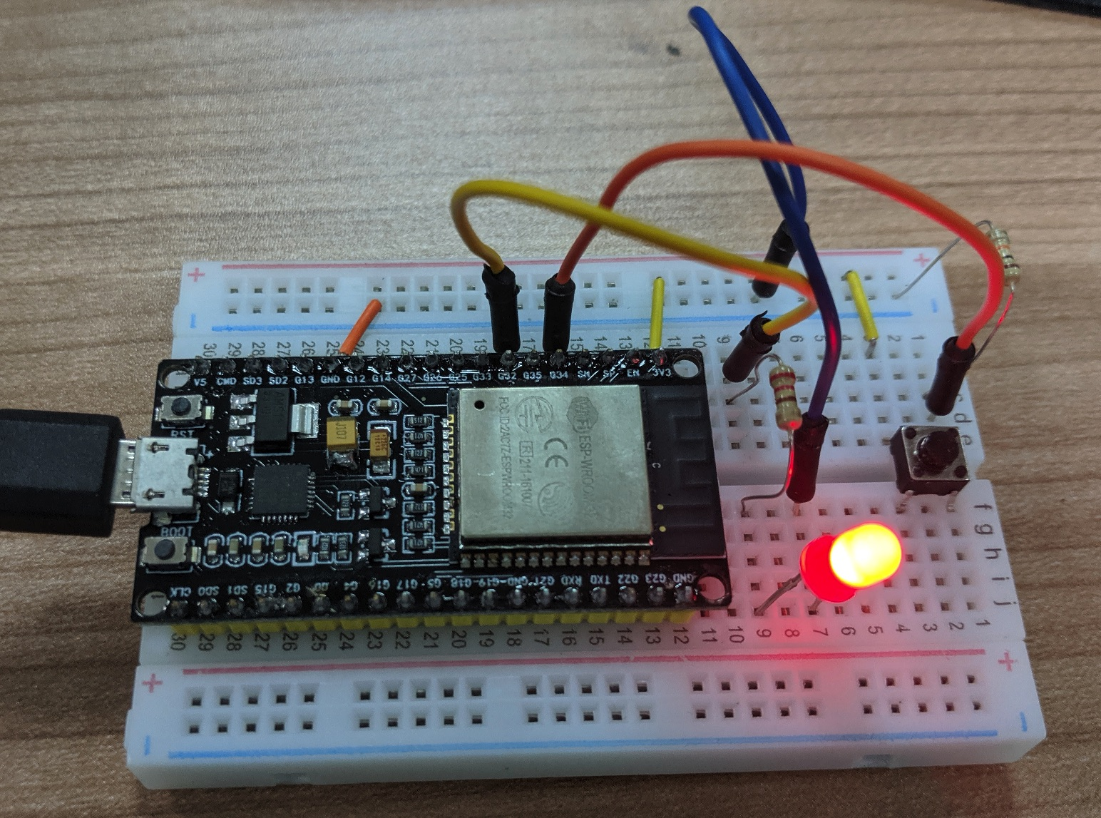
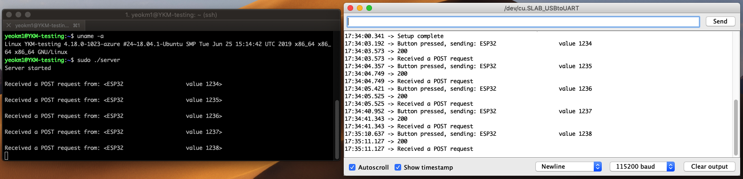
IoT ESP32 MCU workshop 101
Internet of Things 101 Workshop (14 Sept 2019)
SPD IoT 101 workshop (5 Sept 2019)
By: Yeo Kheng Meng (yeokm1@gmail.com)
https://github.com/yeokm1/iot-esp32-mcu-workshop

Slide 2
SDK installation
https://github.com/yeokm1/iot-esp32-mcu-workshop
Install Serial Virtual Com Port drivers for your operating system if needed
https://www.silabs.com/products/development-tools/software/usb-to-uart-bridge-vcp-drivers
Install Arduino IDE:
https://www.arduino.cc/en/main/software
Install ESP32 SDK addon to Arduino IDE
Add the following path to Additional Boards URL configuration
https://dl.espressif.com/dl/package_esp32_index.json

Slide 3
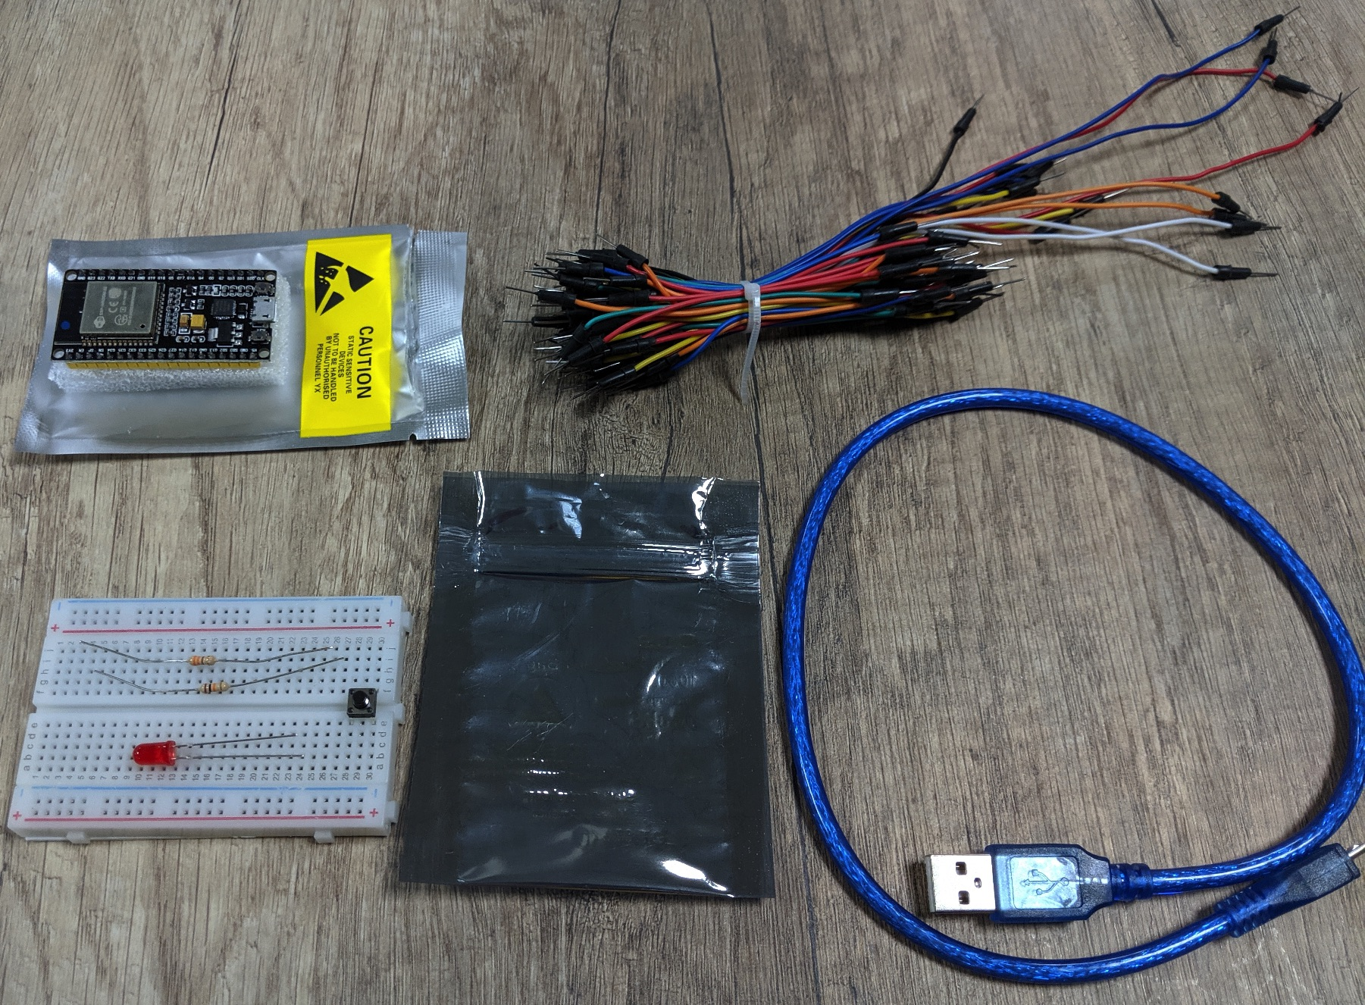
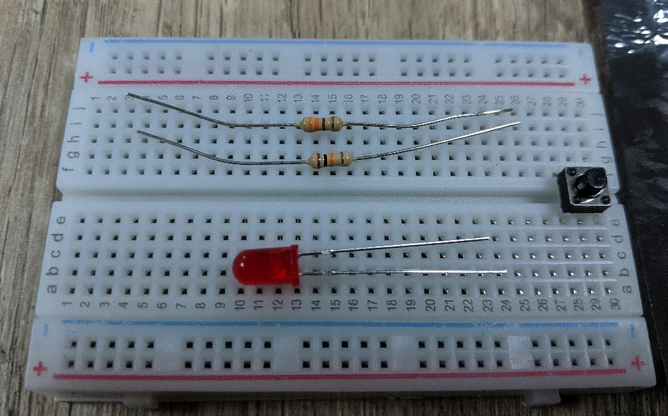
Components Check
ESP32 breakout board
50cm micro-USB cable
Half-size breadboard
Bunch of wires
In ESD bag
Red LED
Push button
330 ohm resistor
10k ohm resistor
330 ohm resistor
10k ohm resistor

Slide 4
Agenda
Background of ESP32 and Arduino
Basics of electronics
Serial - Setting up of software SDK and testing
Blink - Connecting and blinking LED
Button - Connecting button and try to detect press
Debounce - Concept of input debouncing
The “Internet” portion of IoT
Post - Posting Request to a server on button press
Get - Repeatedly polling the server for on or off instruction

Slide 5


Who made the ESP32?
Made by Espressif Systems based in Shanghai
Fabless semiconductor company
Founded by Singaporean Teo Swee Ann in 2008

Slide 6
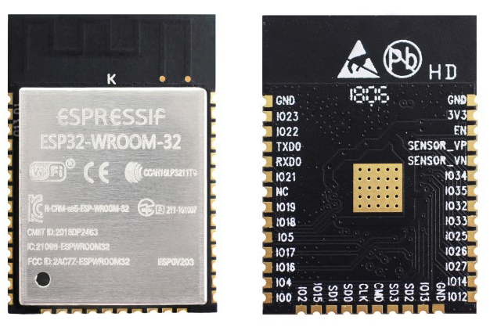
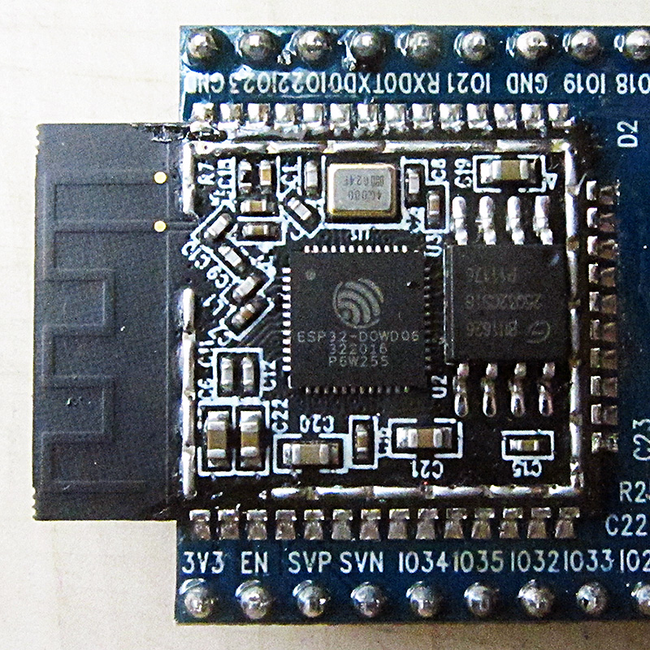
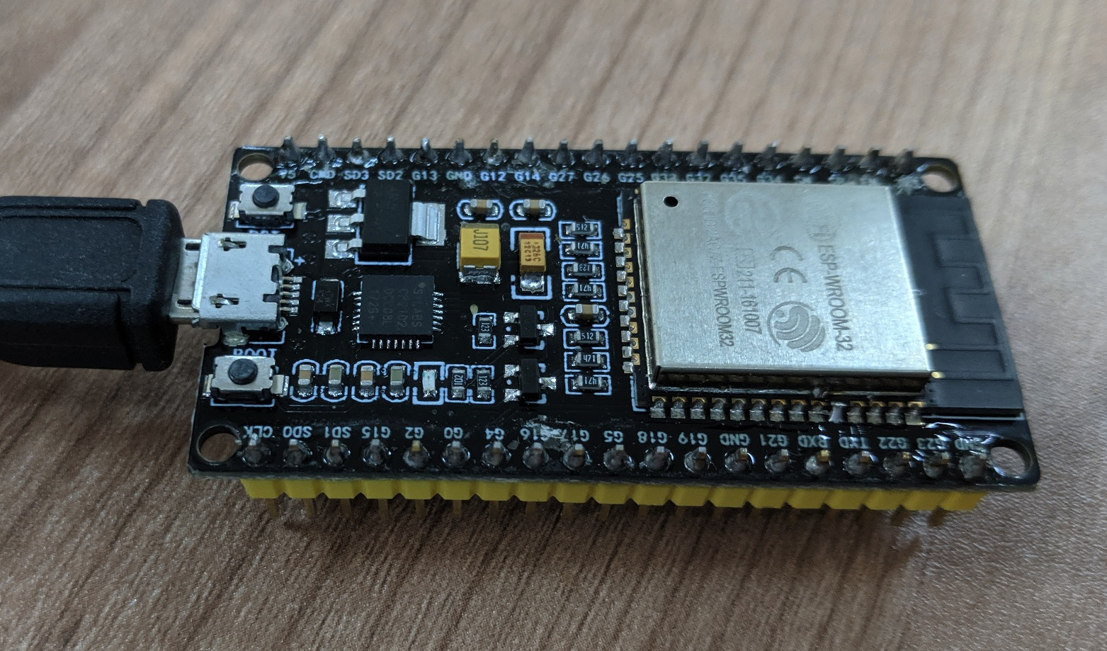
ESP32 chip vs ESP32 module vs ESP32 breakout

Slide 7
ESP32 Specs
Specs | Value
CPU | Xtensa dual/single-core 32-bit LX6 microcontroller, operating at 160/240 MHz
RAM | 520 KiB
Flash memory | 4 - 16 MiB
Network Connectivity | Wifi 802.11n 2.4Ghz + BT 4.2
Peripheral Interfaces | 3x UART, 2x SPI, 2x I2C, ADC, SD touch sensors, etc

Slide 8
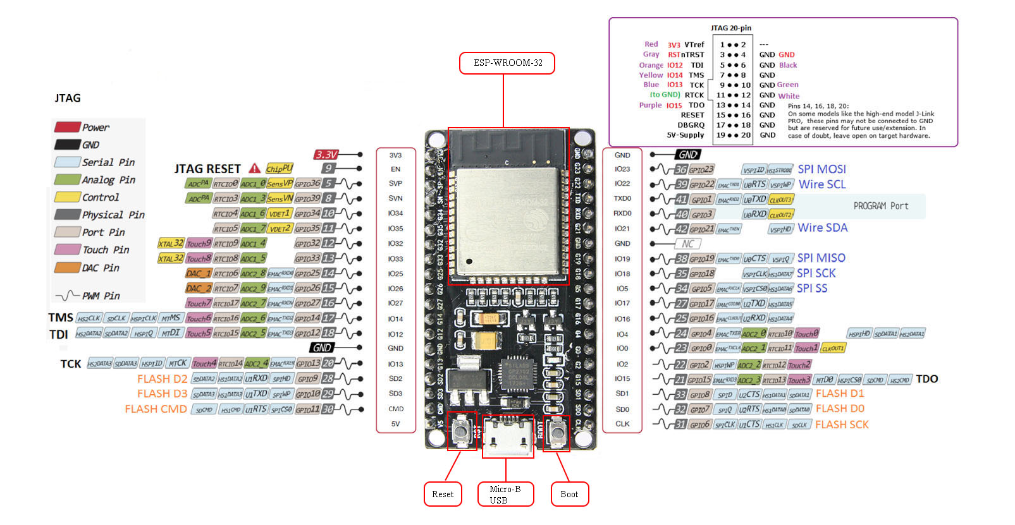

Slide 9
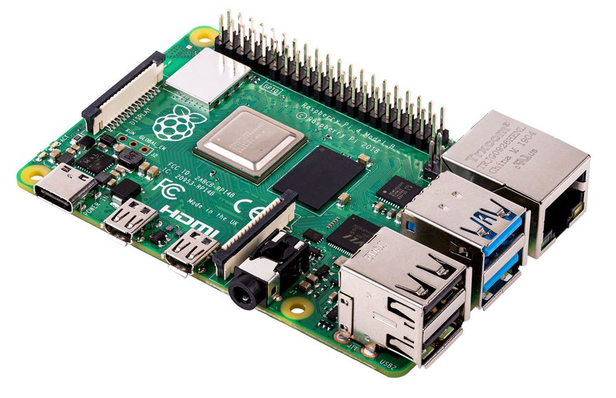
Why not single-board computers like Raspberry Pi?
Specs | Arduino-compatible ESP32 | Raspberry Pi 4 B
CPU type | Microcontroller | Microprocessor
Speed | Dual Core 160/240Mhz | Quad core 1.5 Ghz
RAM | 520KB | 1 - 4 GB
GPU/Display | None | VideoCore VI GPU, 4K
Disk | 4 MiB | Depends on microSD card
Other connectivity | Wifi 802.11n 2.4Ghz + BT 4.2 | USB, Ethernet, HDMI, audio, Wifi 2.4/5Ghz 802.11ac, BT 5.0
Operating System | None | Linux (usually Raspbian)
Real Time Operation | Better | Poorer
Typical Power consumption | 0.8W | 8W
Price (SGD) | $30 | $50 - $80

Slide 10
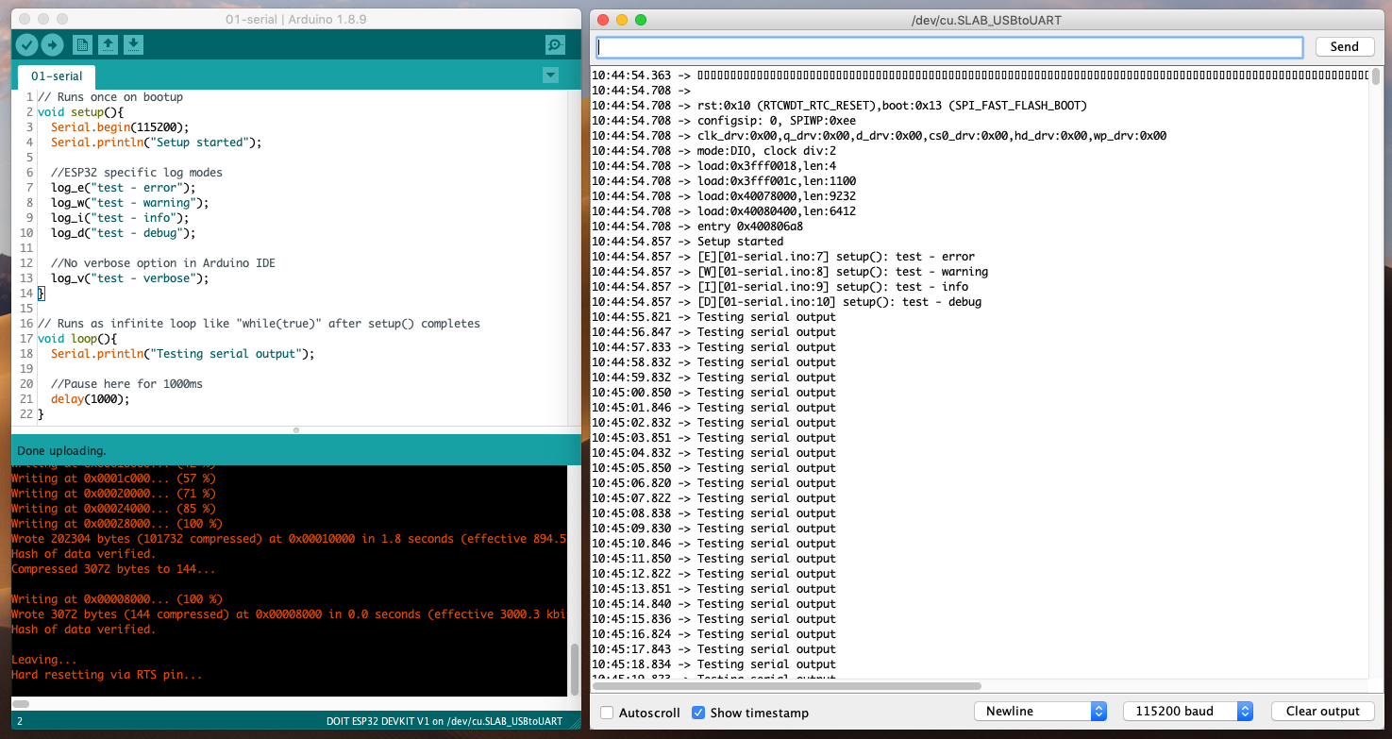

Arduino SDK
Easy to use cross-platform IDE for microcontroller programming
Support for many microcontrollers
C/C++ language
Numerous libraries

Slide 11
01-Serial
Verify Arduino SDK installed correctly as in the parent README.md
How to flash an Arduino program?
Using the serial console and ESP32 log facility

Slide 12
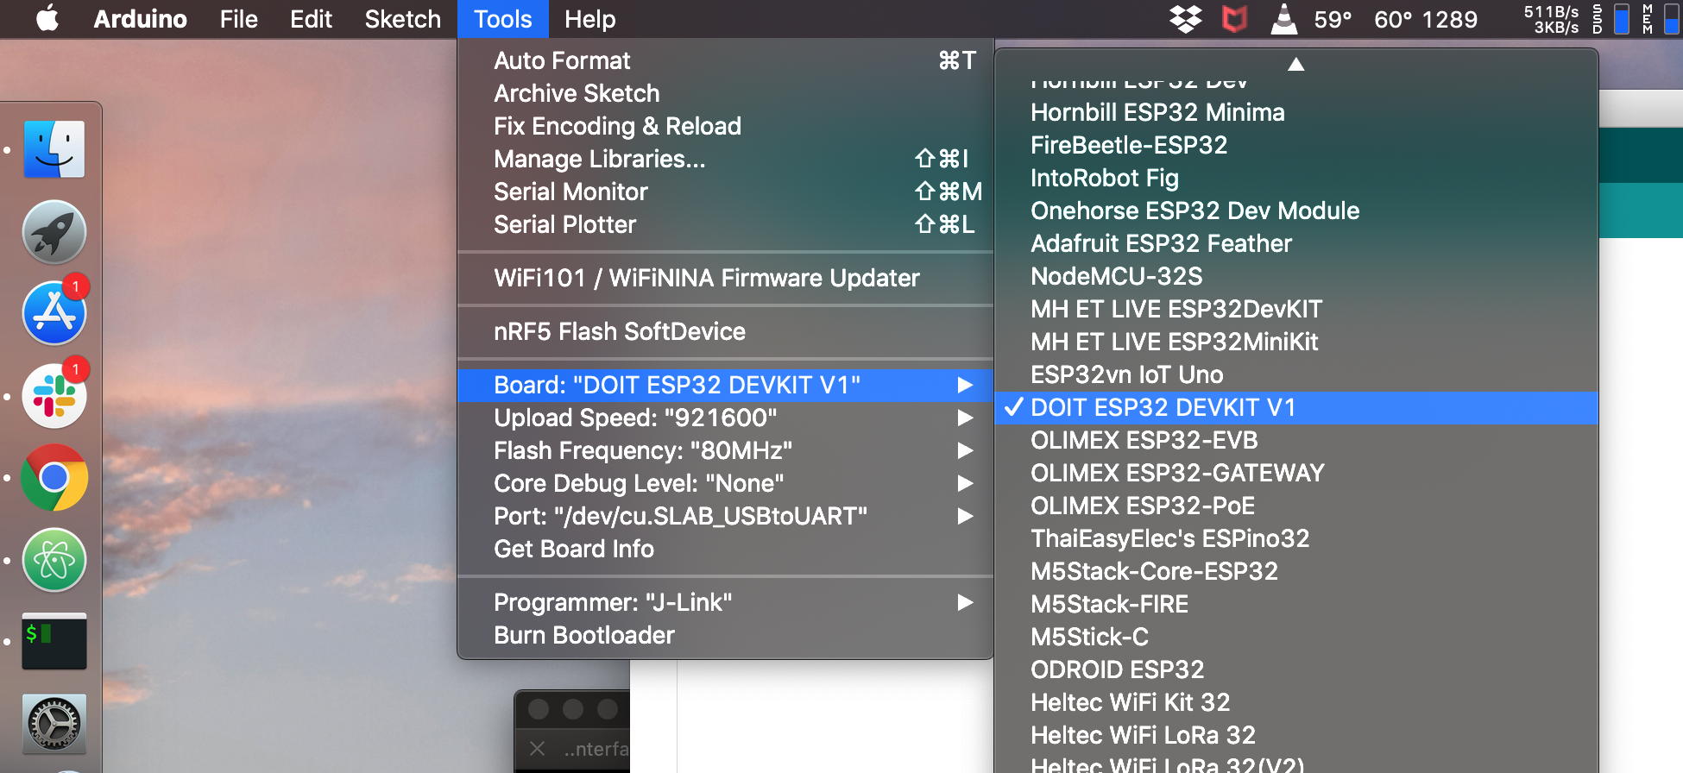
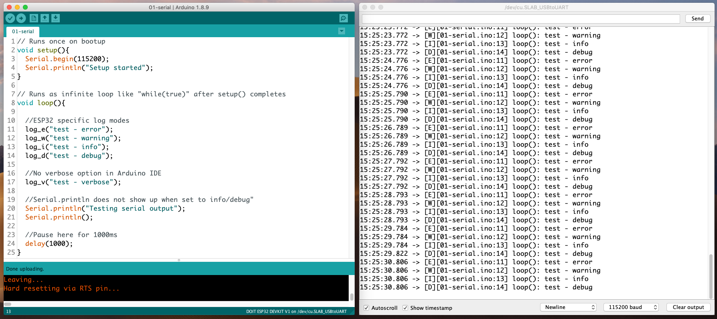
Magnifying glass opens serial console
Show Timestamps
Newline
115200 baud

Slide 13
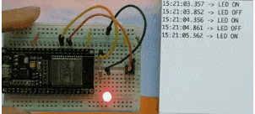
02-Blinky
Connect an LED
Blink from the LED

Slide 14
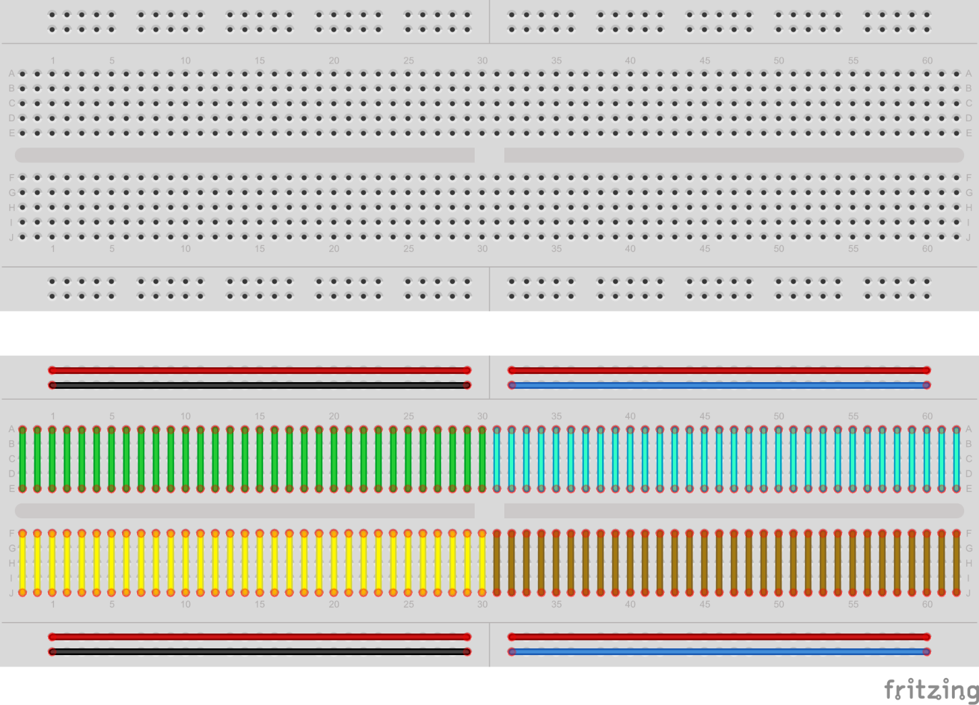
Half/Full Breadboard
Base Prototyping component
Continuous lines indicate those holes are connected together
Horizontal usually for power
Convention: Red for +, Black/Blue for -
Vertical for your components

Slide 15
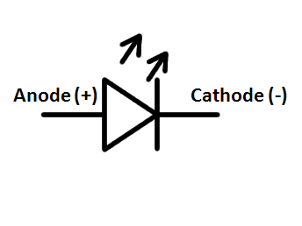
LED
“A light-emitting diode (LED) is a semiconductor light source that emits light when current flows through it. ”
Diode: Component allowing one-way current flow
Anode +: Longer leg
Cathode -: Shorter Leg

Slide 16
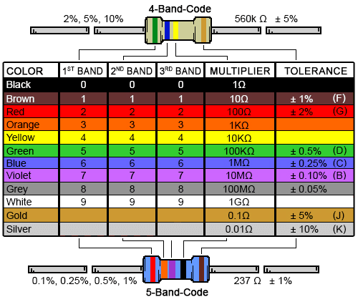
Resistor
Resists the flow of current
Resistor Colour bands
4-band 330 ohm
Orange, Orange, Brown, Gold
3, 3, x10, 5% tolerance
4-band 10K ohm
1, 0, x1000, 5% tolerance
Blown, Black, Orange, Gold

Slide 17
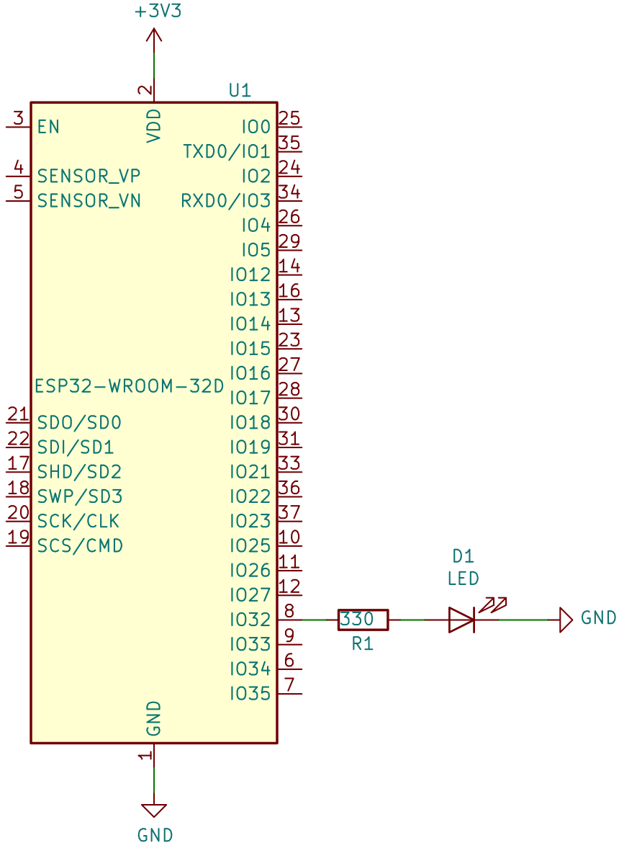
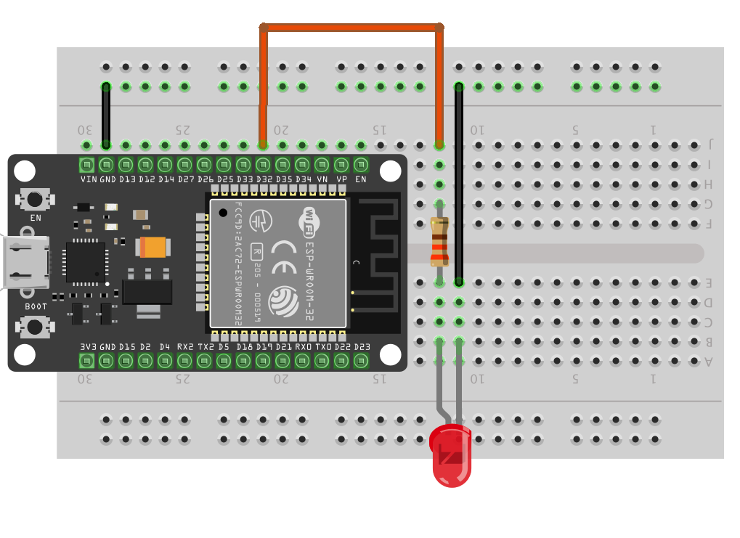
Connecting the LED setup
Unplug USB cable before working on electronics
Breadboard + ESP32 board (G32, GND) + 330 ohm resistor + LED + wires
Pinouts may differ slightly from diagram. Always check the pin labels!
GND
G32

Slide 18
Program the board with 02-blinky.ino

Slide 19
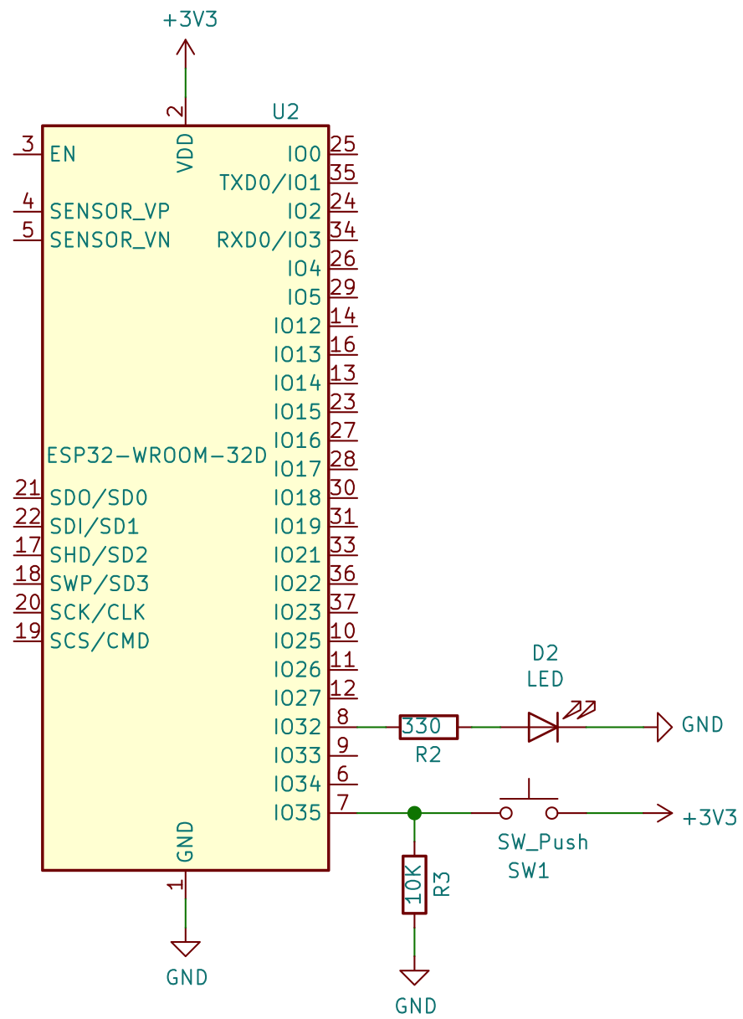
03-button button setup
10k ohm resistor + button + wires -> G34
Actual breakout 3V3 pin position differs from picture
“Pull down” resistor setup
GND
G32
G34
3V3

Slide 20
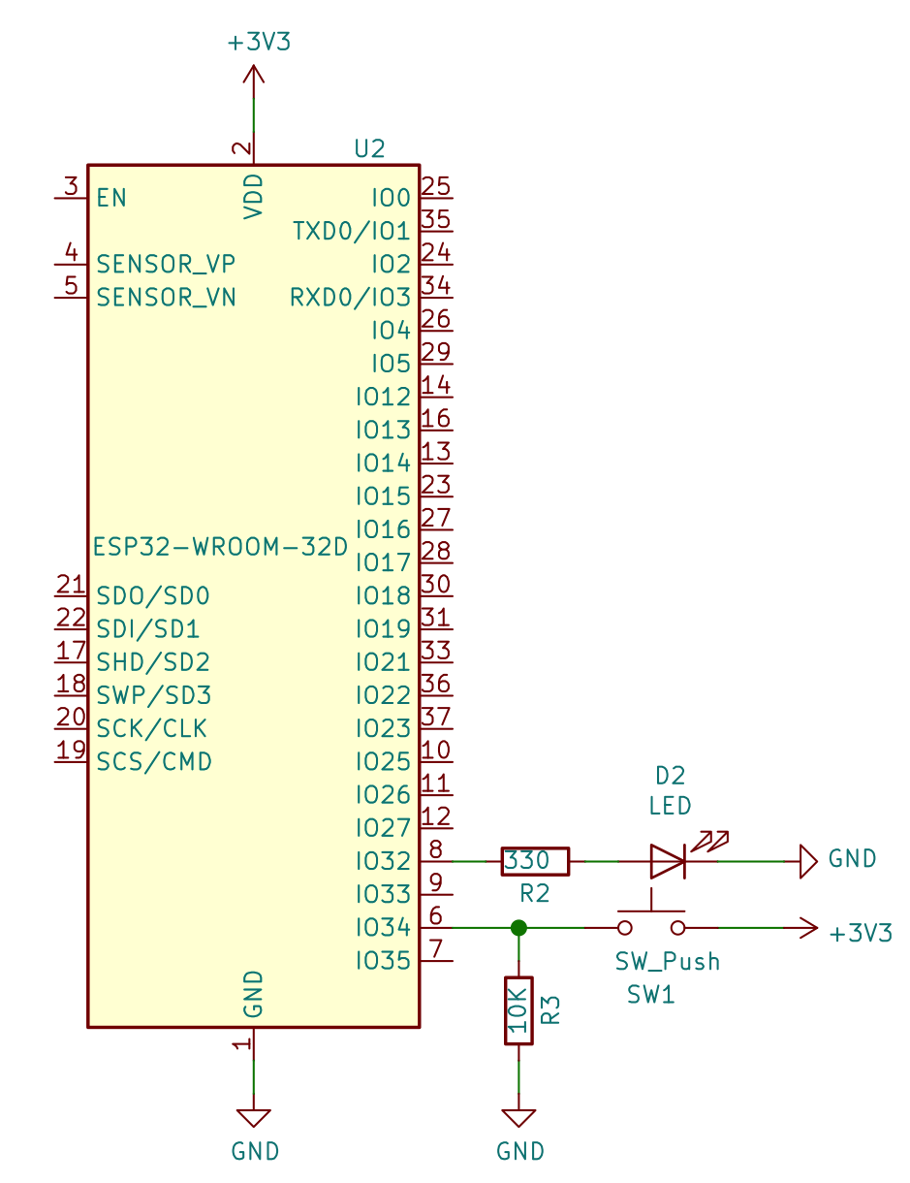
Pull down resistor for button
Resistor “pulls” IO34 to ground when button is released
Guarantees that IO34 pin goes to 0
GND
G32
G34
3V3

Slide 21
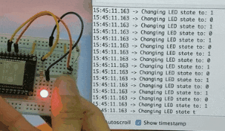
Program the board with 03-button.ino
We want to toggle LED on each button press
Observe looping speed of button press detection is too fast to be useful

Slide 22
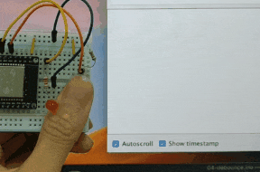
04-debounce
Process one input within an interval

Slide 23
05-wifi-post
Making a POST request to the server via a button press
Able to receive a POST request using a Go program
WIFI_SSID: iot-workshop
WIFI_PASS: esp32isgreat
HOST: …

Slide 24
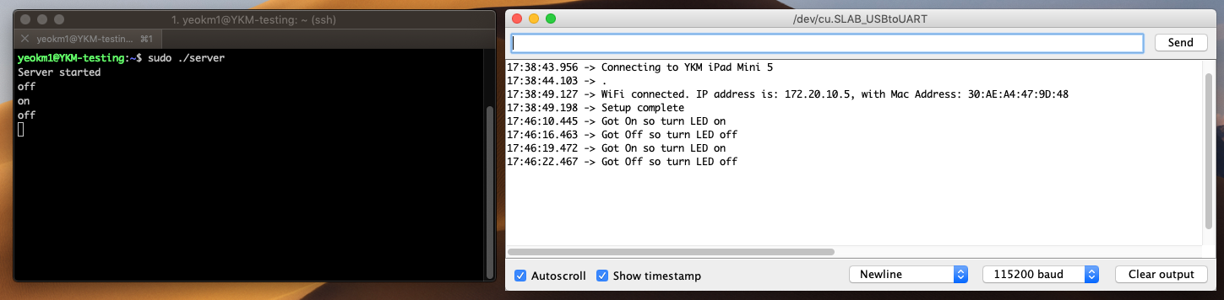
06-wifi-get
Making a Get Request to a server to get instruction
Serve a GET request using a Go program
WIFI_SSID: iot-workshop
WIFI_PASS: esp32isgreat
HOST: …

Slide 25
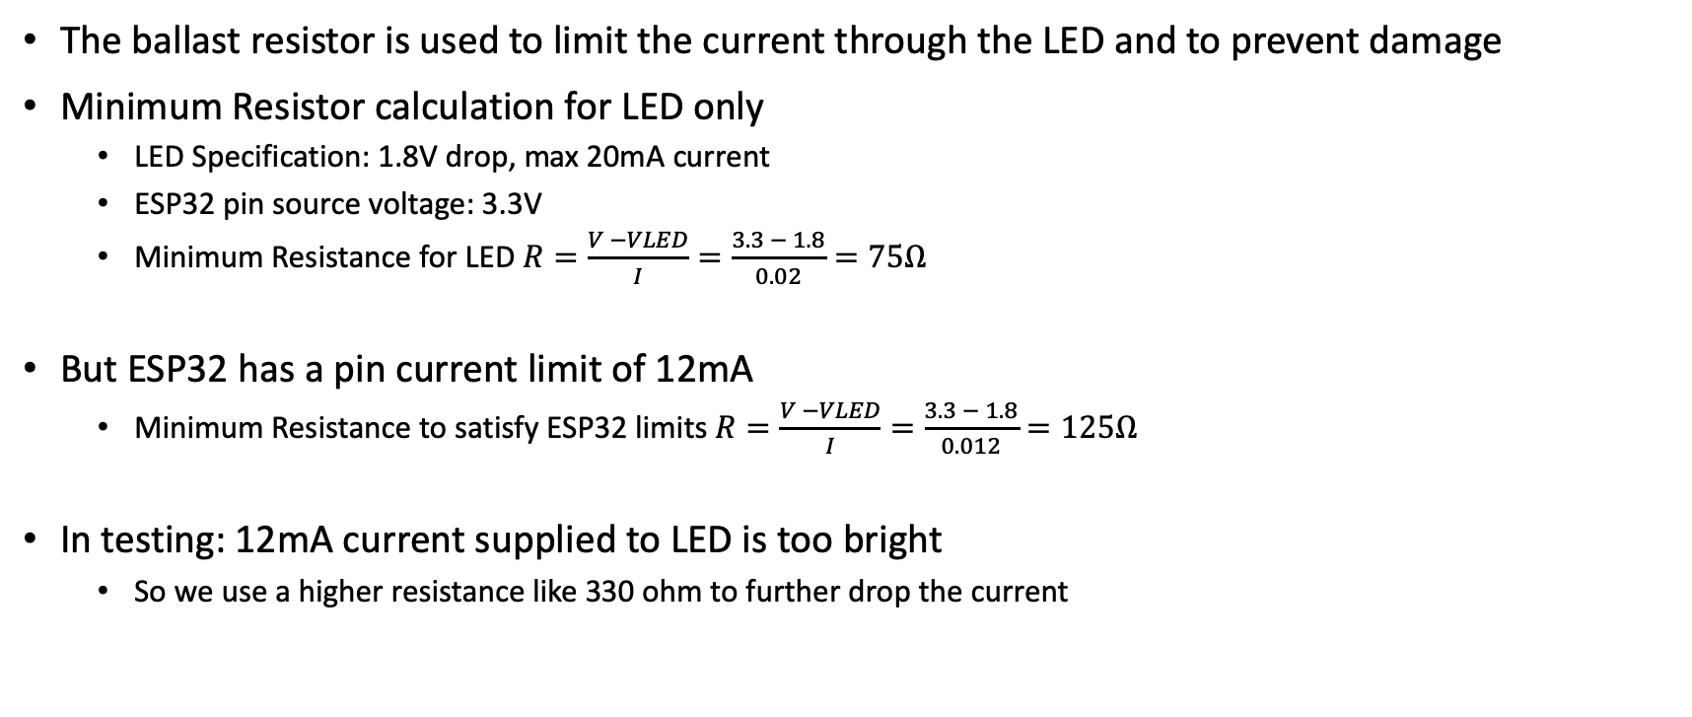
Why LED needs a resistor?
The ballast resistor is used to limit the current through the LED and to prevent damage
Minimum Resistor calculation for LED only
LED Specification: 1.8V drop, max 20mA current
ESP32 pin source voltage: 3.3V
Minimum Resistance for LED $R=\frac{V −VLED}{I}=\frac{3.3 − 1.8}{0.02}=75Ω$
But ESP32 has a pin current limit of 12mA
Minimum Resistance to satisfy ESP32 limits $R=\frac{V −VLED}{I}=\frac{3.3 − 1.8}{0.012}=125Ω$
In testing: 12mA current supplied to LED is too bright
So we use a higher resistance like 330 ohm to further drop the current

